Slide 1
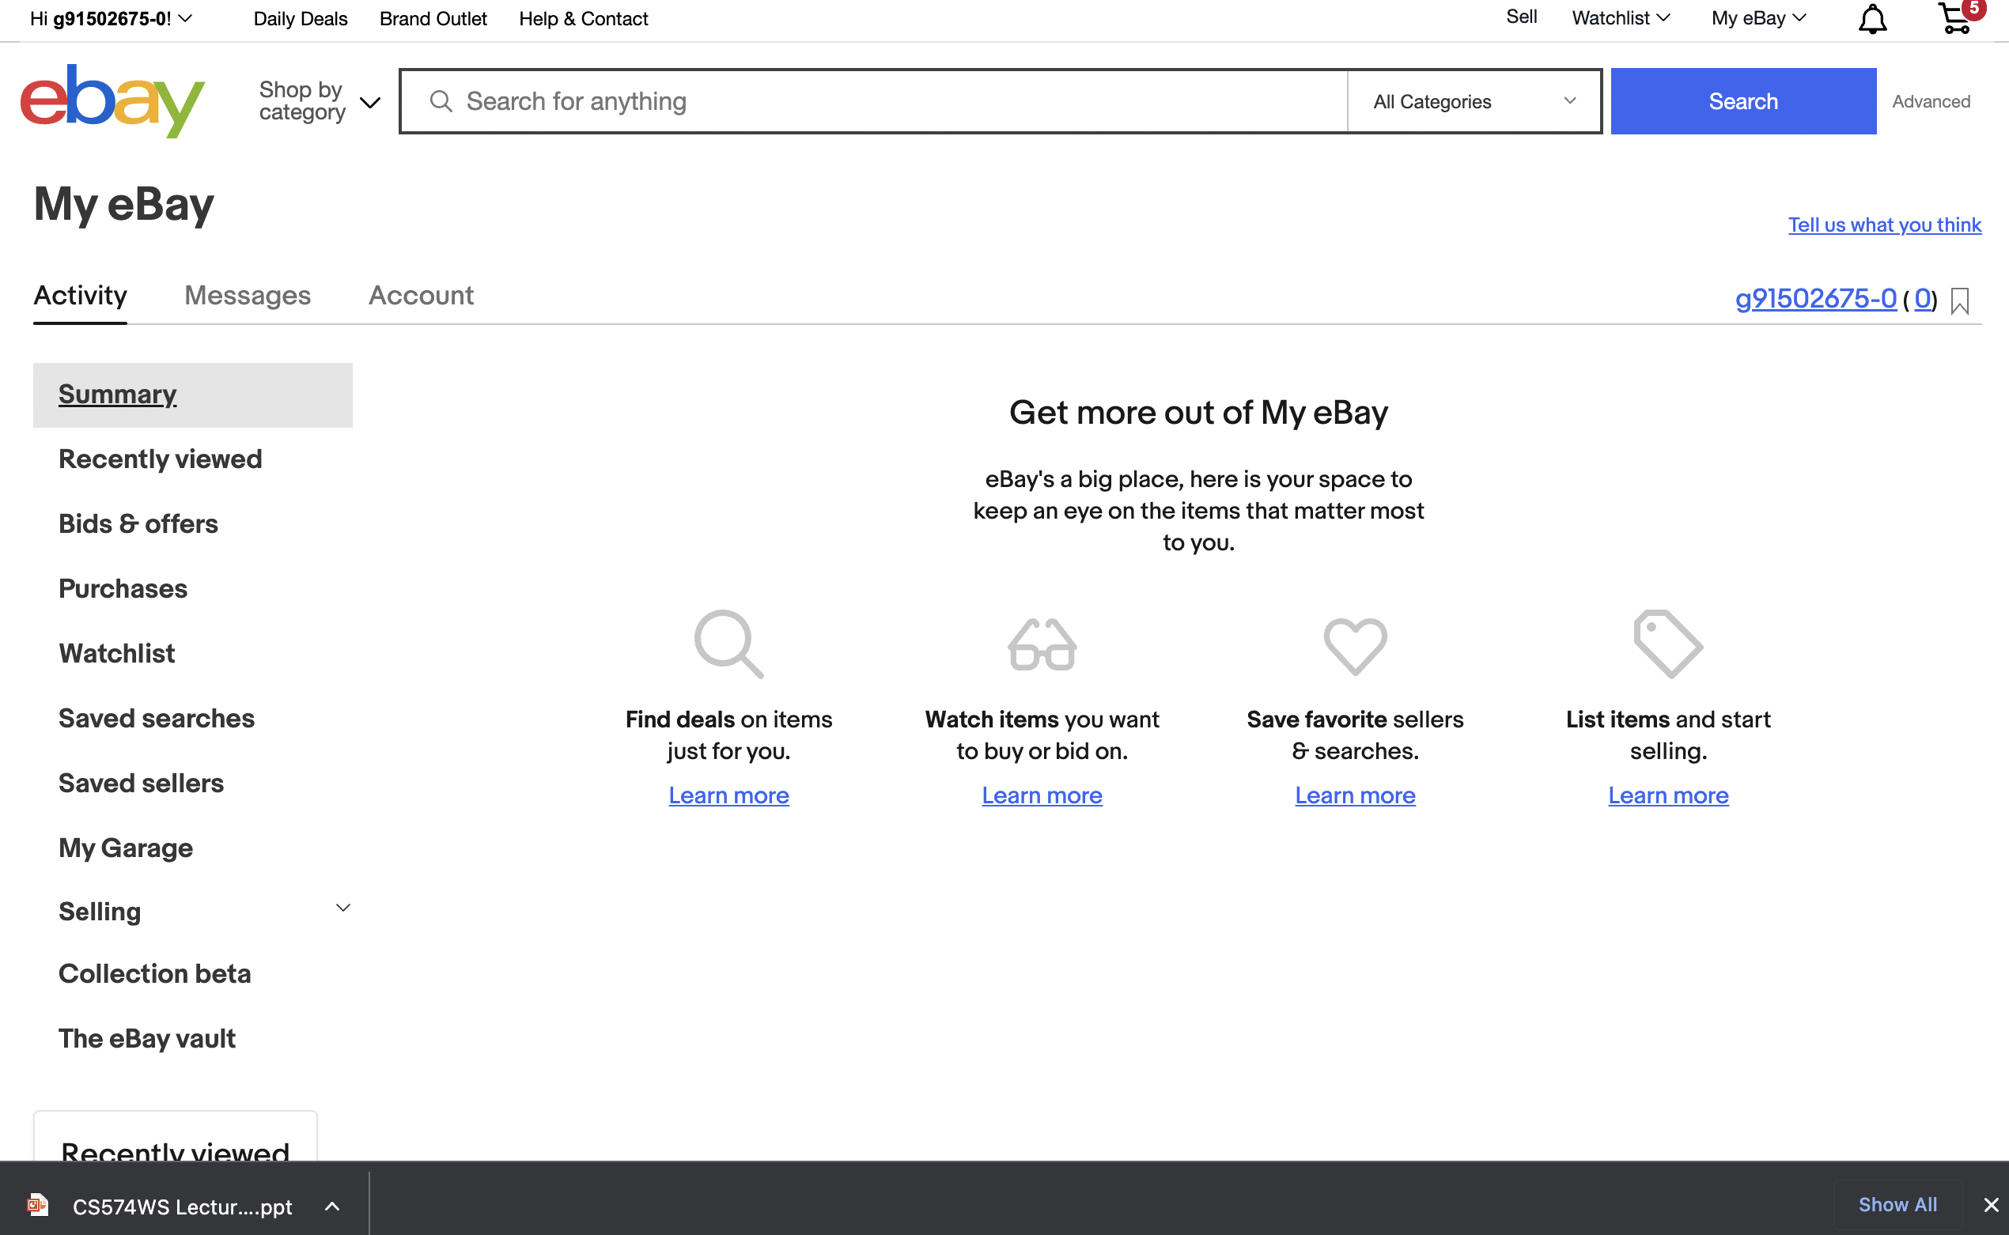
on the “my eBay” screen.

Slide 2
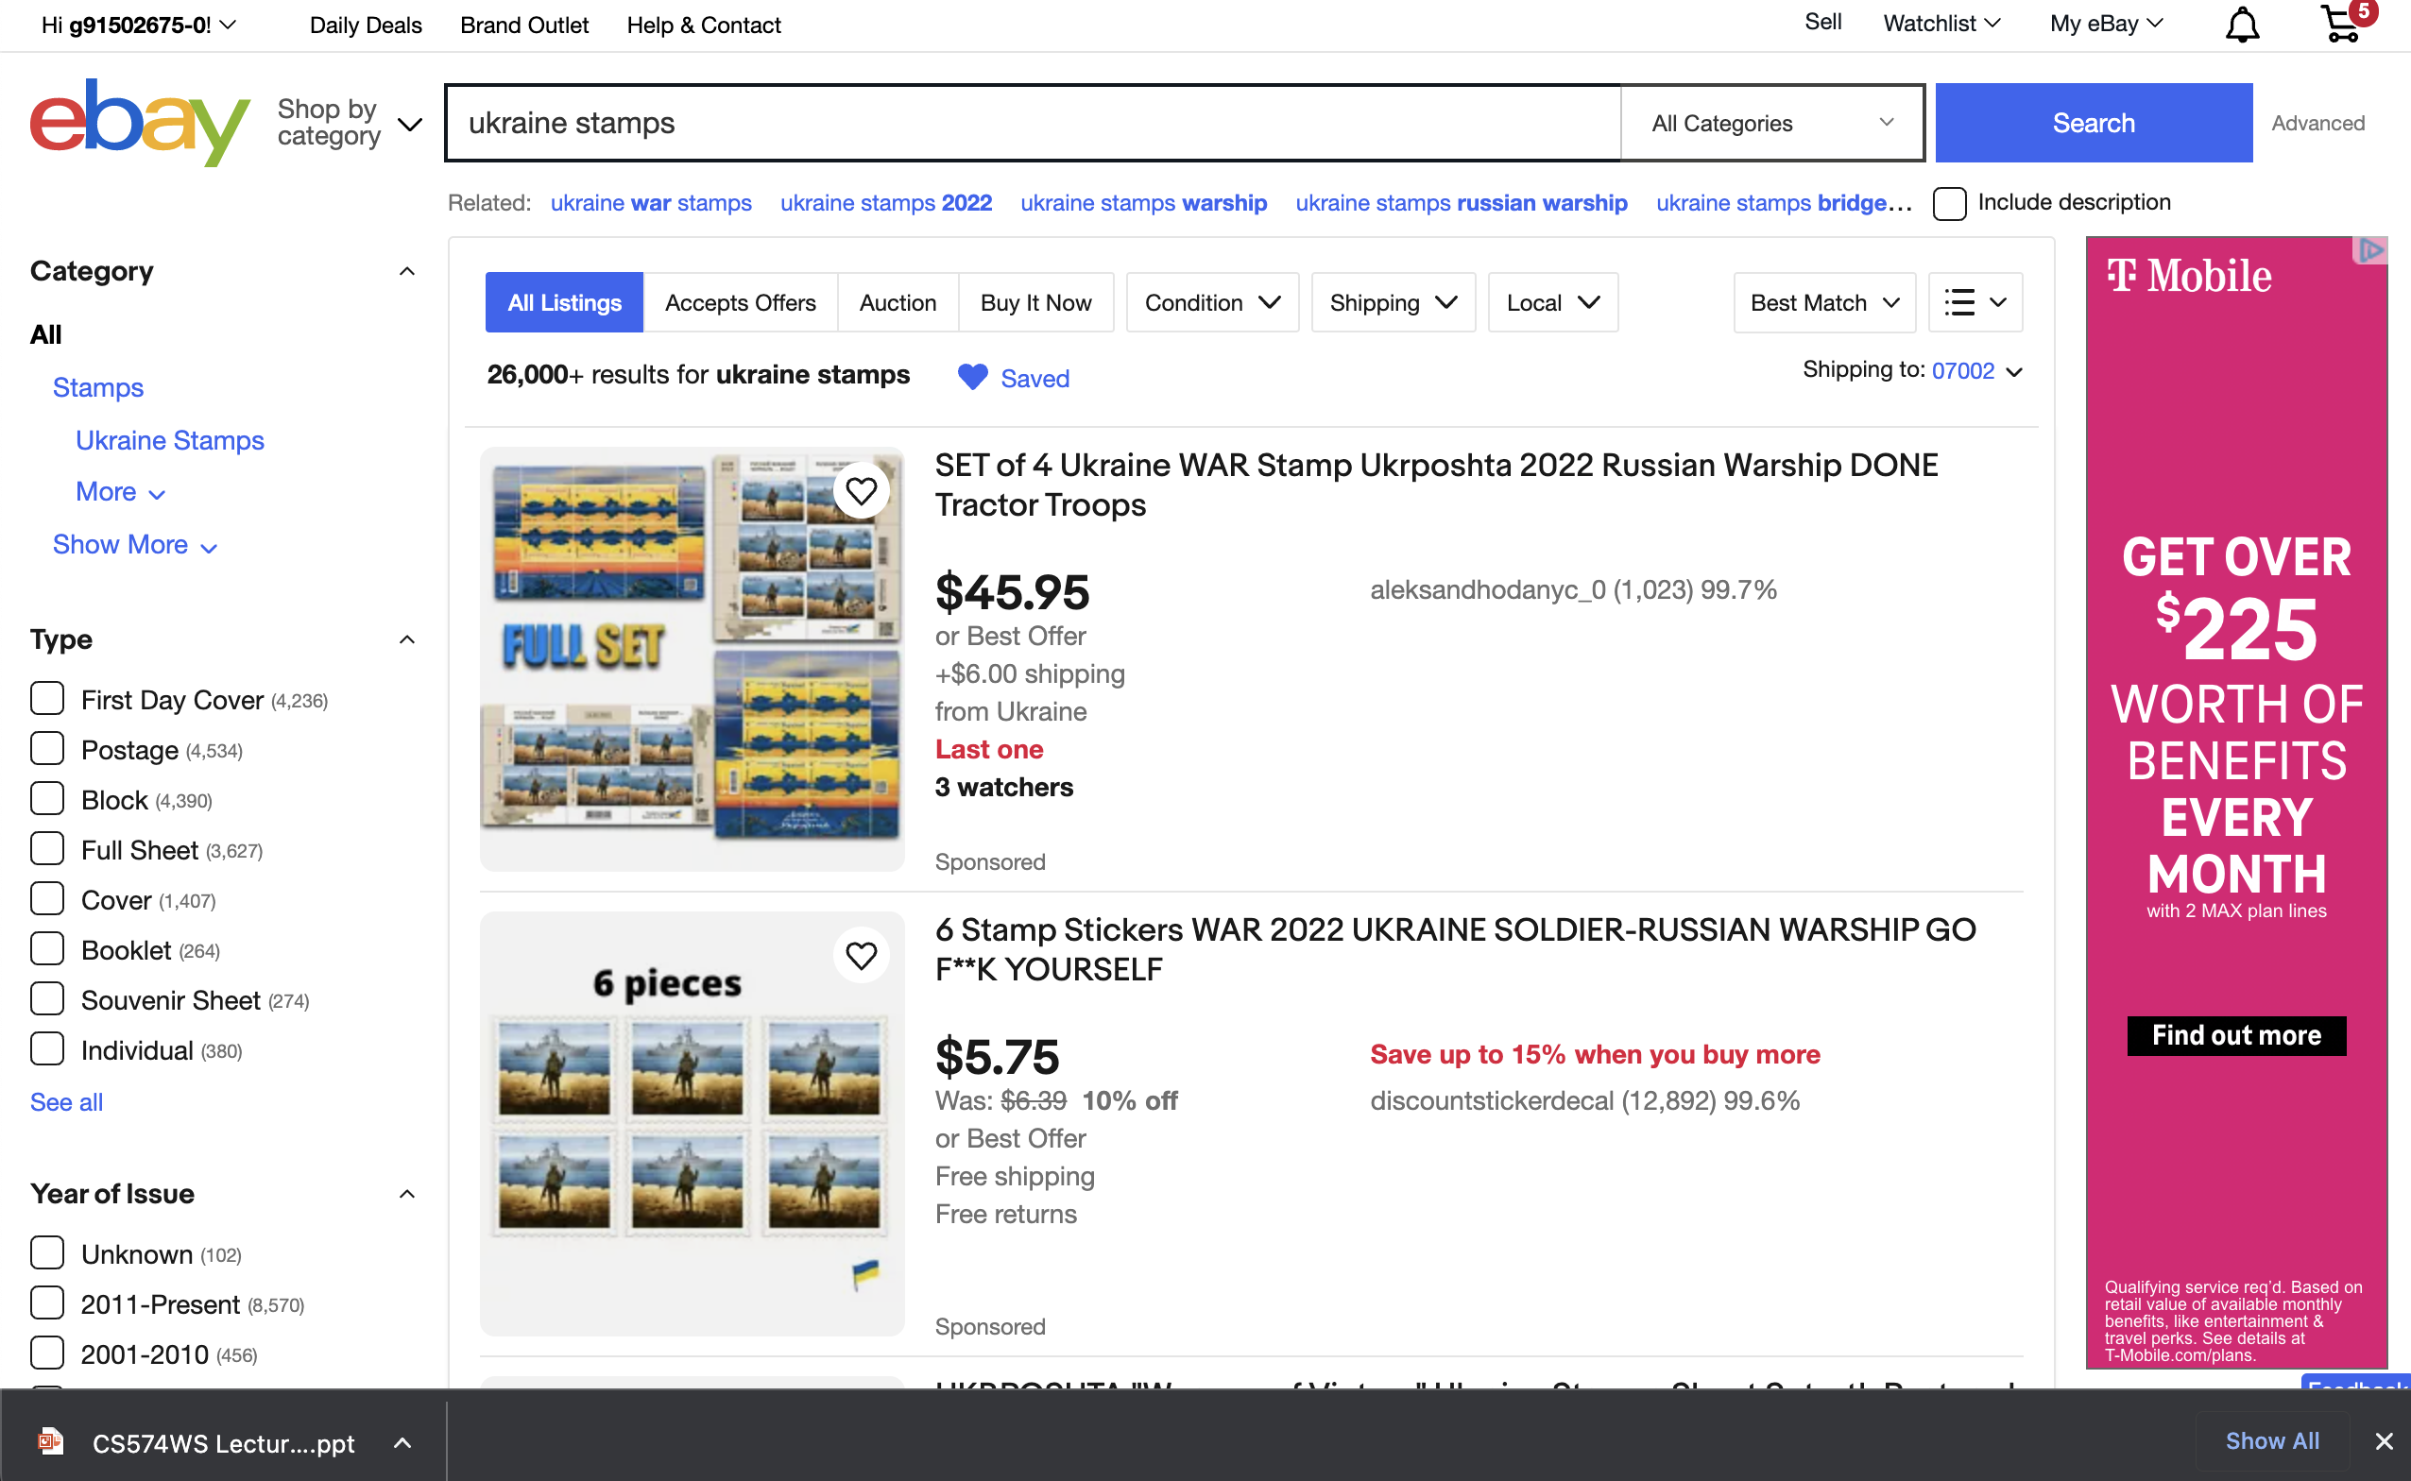
Hit the search button, resulting screen

Slide 3
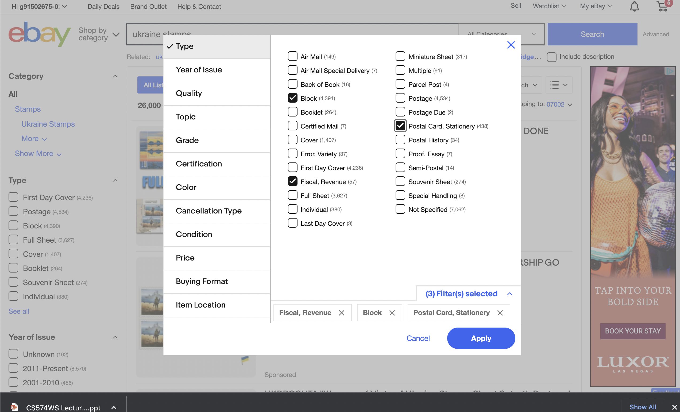
After I chose the parameter values and click on the Save button on the dialog box.

Slide 4
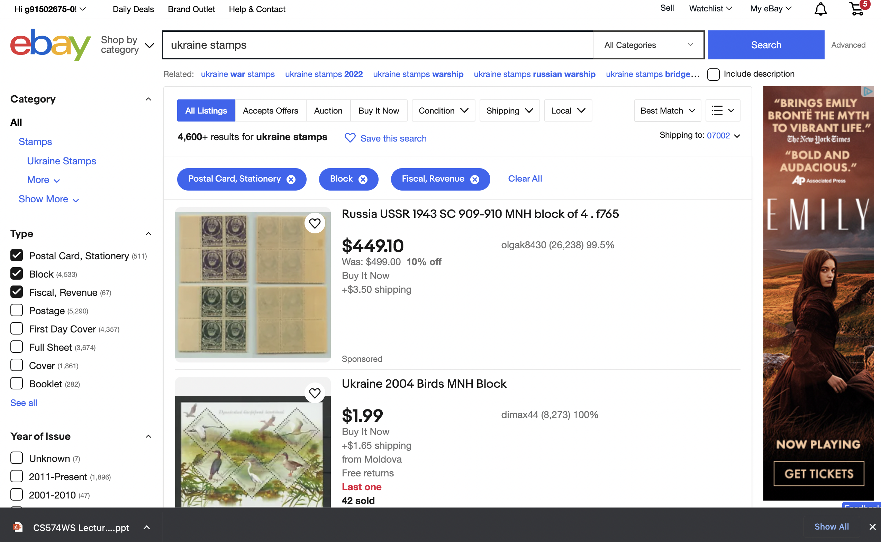
create an advanced search, for something other than first saved search; be sure to use at least three or four of the possible advanced search parameters.

Slide 5
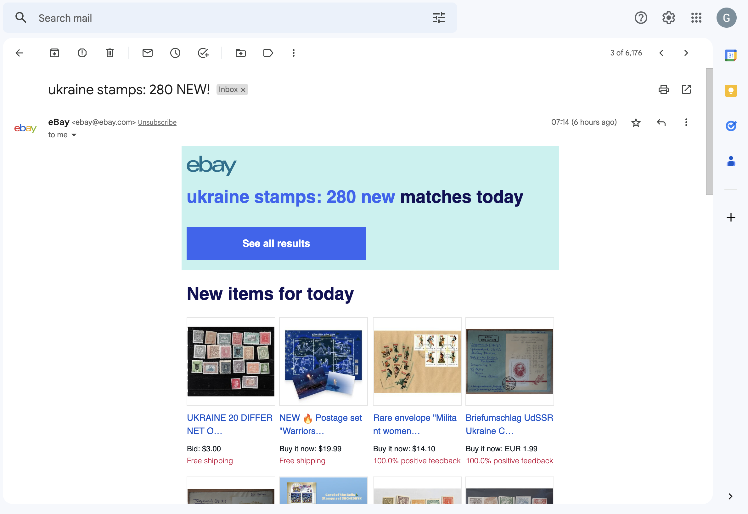
email matches for the two searches that saved

Slide 6
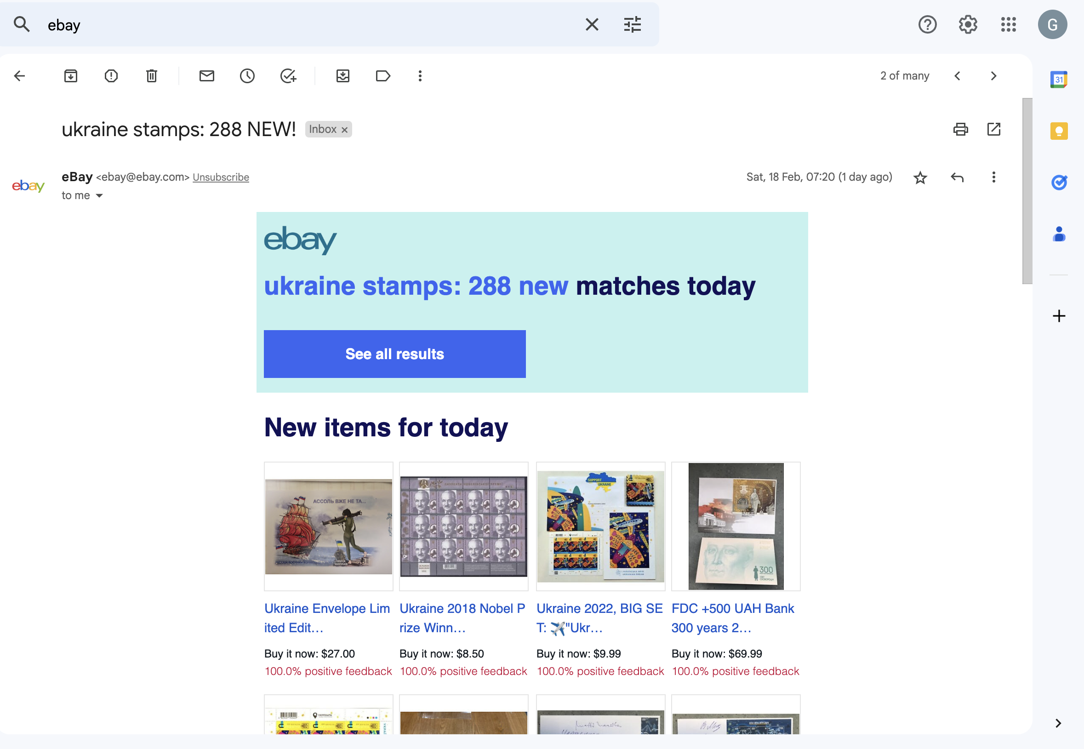
email matches for the two searches that saved

